Slide 1




TypeScript Mastery
A Step-by-Step Learning Experience
Presented by Sir Ameen Alam

Slide 2









Meet Ameen Alam
An accomplished professional with extensive expertise in Cloud Computing and DevOps. He holds multiple certifications, including AWS Developer Associate and Kubernetes Application Developer, and has over 8 years of experience in the IT, finance, and banking industry. Ameen is currently the Founder & CTO at Doblier Inc.
fb.com/SheikhAmeenAlam linkedin.com/in/ameen-alam instagram.com/sheikhameenalam yt.com/ameenalamofficial

Slide 3

Meet Our Faculty

Slide 4




Whatsapp
Channel:
Latest News
https://bit.ly/49werTR

Slide 5
Books

Slide 6
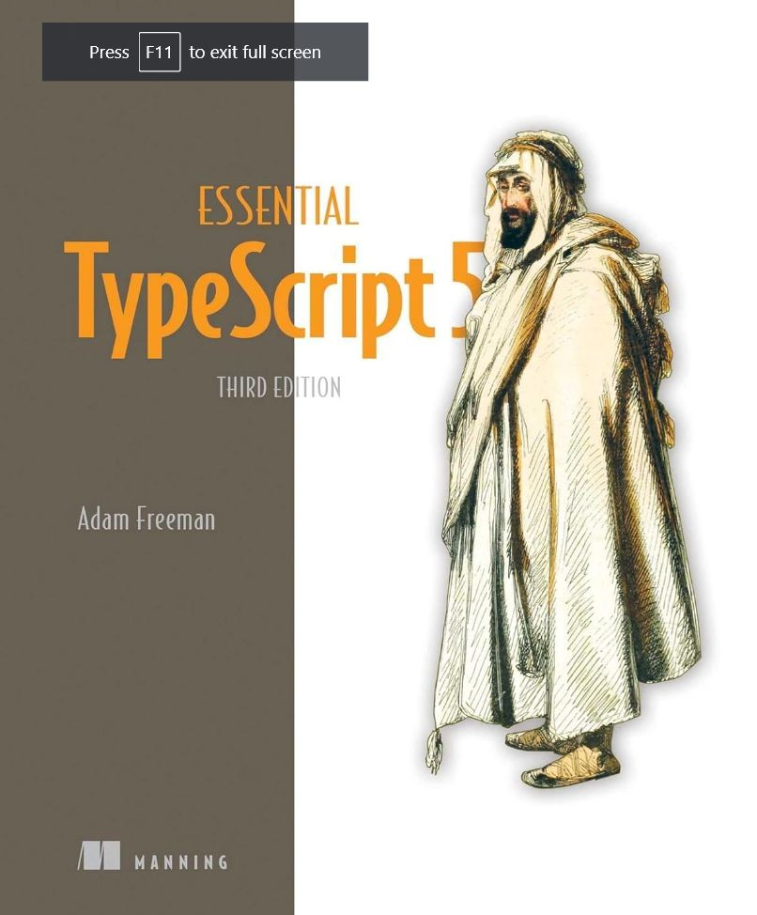
ESSential TypeScript 5
Third Edition by Adam Freeman (Author)

Slide 7





Table of contentS
02
Setting Up Your Environment
Install Node.js, Git, TypeScript, and VS Code
04
HandS-on ExerciSeS
Getting Started Exercises with TypeScript and Node.js
01
Introduction to TypeScript
Brief overview of TypeScript
03
Your FirSt TypeScript Program
Write a simple "Hello, World!" program

Slide 8






01
Introduction to TypeScript
TypeScript as a statically typed superset of JavaScript

Slide 9






Introduction
TypeScript is a superset of JavaScript that adds optional static typing to the language. This means that TypeScript code can be checked for errors during development, which can help to catch bugs early on.
TypeScript also provides other features that make it a more powerful and versatile language than JavaScript, such as generics, interfaces, and type aliases.

Slide 10










UnderStanding Programming LanguageS
Imagine you're planning a trip. To communicate effectively with people in the places you'll visit, you might learn their languages. Similarly, programming languages are like human languages but for computers. They allow us to give instructions to computers and tell them what to do.

Slide 11
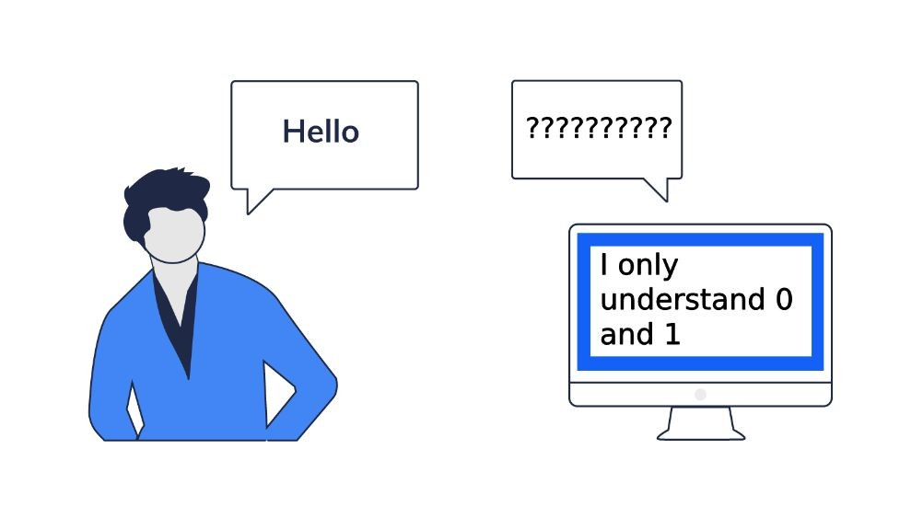

Slide 12
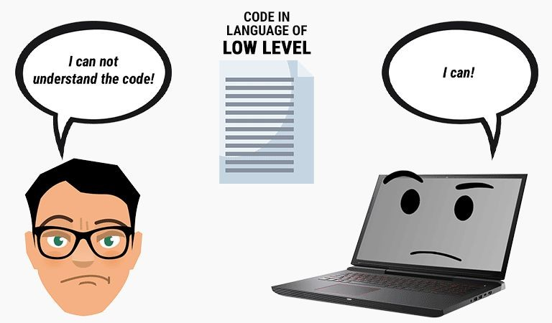

Slide 13



Hello

Slide 14


Slide 15
Why Learn Programming?
In today's digital world, programming skills are becoming increasingly valuable. Just like knowing English opens up opportunities in various fields, programming can lead to exciting careers in technology, web development, and software engineering. It also empowers you to create your own digital solutions and automate tasks.

Slide 16




Why ChooSe TypeScript?
TypeScript is a powerful and versatile programming language that adds optional static typing to JavaScript, making it more reliable and maintainable. Imagine a chef using a recipe with precise measurements and instructions compared to one with vague guidelines. TypeScript is like the chef with a precise recipe, ensuring consistent and error-free outcomes.

Slide 17

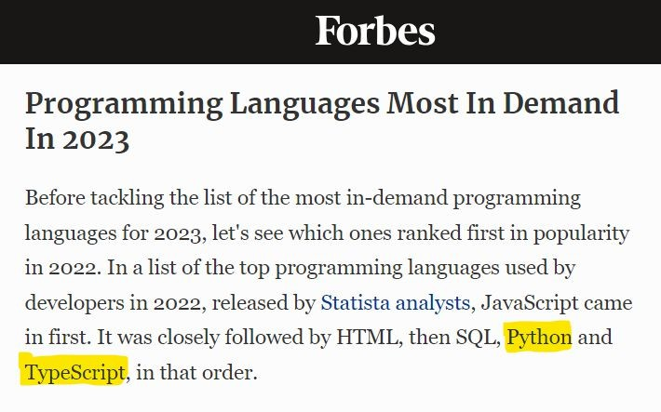

Slide 18

5302+ companieS reportedly uSe TypeScript in their tech StackS

Slide 19
Chapter #1 UnderStanding TypeScript

Slide 20
TypeScript’S headline featureS are focuSed on developer productivity

Slide 21

Who iS Developer?

Slide 22
Who iS Developer?
Imagine you're building a house. You have architects who design the blueprint, engineers who understand how to make it structurally sound, and construction workers who put everything together. In the world of technology, developers play a similar role.

Slide 23
Who iS Developer?
Developers are the builders of the digital world. They create the software, websites, apps, and other digital tools that we use every day.
They are the ones who?

Slide 24
TranSlate ideaS into reality
Just like architects turn sketches into houses, developers turn ideas into working software.
They use programming languages to write code that instructs computers what to do.

Slide 25
Solve problemS with code
Whether it's making online shopping easier or helping us navigate a new city, developers use their skills to solve problems creatively and efficiently using code.

Slide 26
Connect people and information
From social media platforms to online banking systems, developers build the digital infrastructure that allows us to connect with each other and access information.

Slide 27
There are different typeS of developerS, each with their own SpecializationS
Front-end developers: They focus on the visual elements and user interface of websites and apps.
Back-end developers: They work behind the scenes, building the logic and server-side functionality of software.
Full-stack developers: They have expertise in both front-end and back-end development.

Slide 28
You don't need a Specific degree to be a developer

Slide 29


Slide 30
TypeScript Productivity FeatureS
Static types Access control keywords
Concise class constructor syntax Help prevent common coding errors

Slide 31
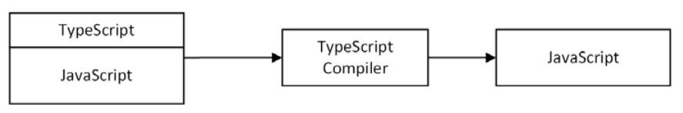
TypeScript productivity featureS are applied to JavaScript code.
TypeScript package includes a compiler Compiled file can be executed by a JavaScript runtime, such as Node.js or a browser

Slide 32
The TypeScript TranSformation to JavaScript Code

Slide 33
TypeScript with more focus and applying its features just to the parts of your code that are especially complex or that you expect to cause problems.

Slide 34
Some TypeScript features are implemented entirely by the compiler and leave no trace in the JavaScript code that is executed when the application runs.

Slide 35
TypeScript enhances JavaScript, but the result is still JavaScript, and development in a TypeScript project is largely a process of writing JavaScript code.

Slide 36

Chapters 3 and 4 describe the JavaScript features

Slide 37
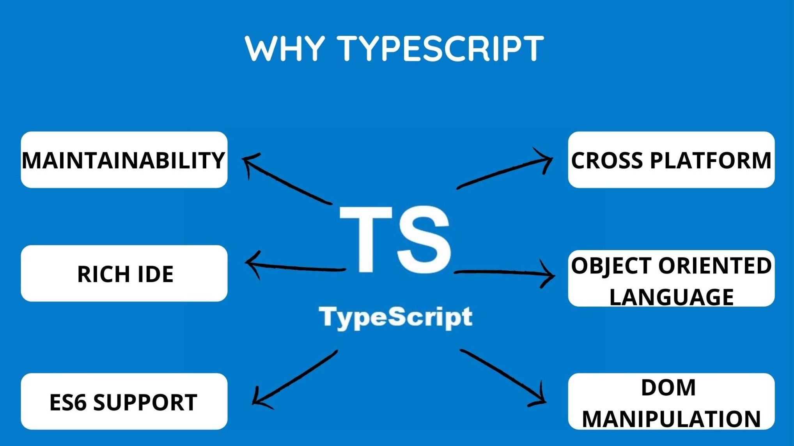

Slide 38
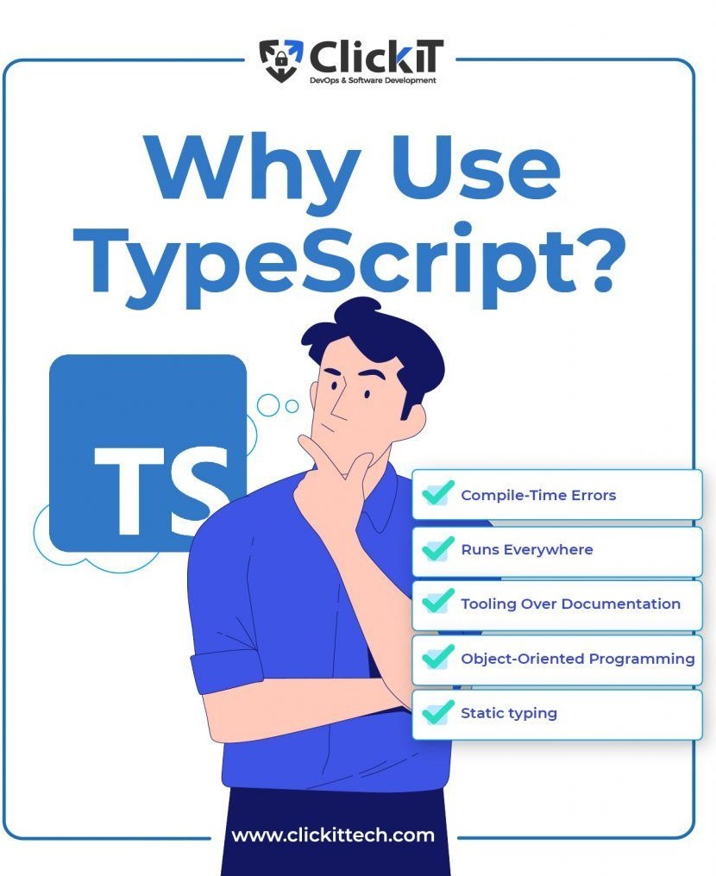
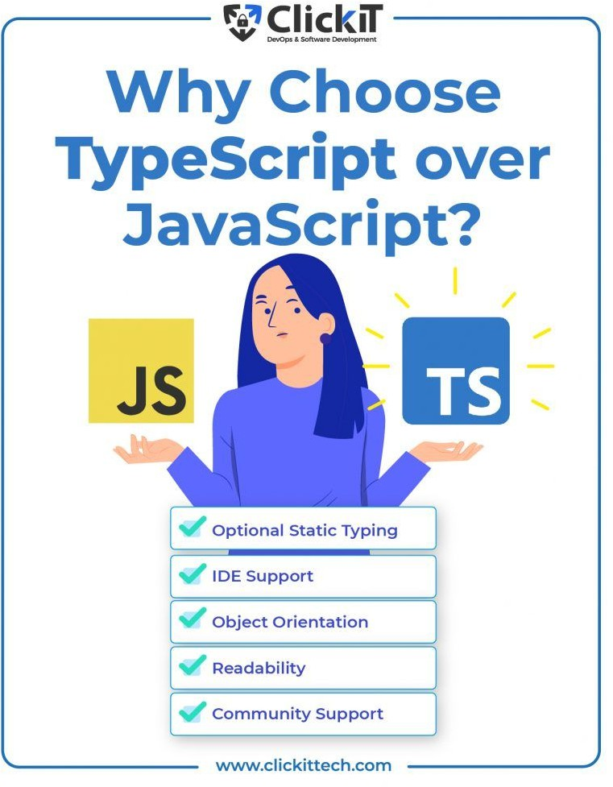

Slide 39


Slide 40
Real-World Analogy: Baking a Cake
Think of baking a cake as an analogy for programming. The recipe is like the code, and the ingredients are like the data. Just as following a recipe with the correct ingredients leads to a delicious cake, using the right code with the appropriate data produces the desired result in programming.

Slide 41


Slide 42
Sir Zia Khan
A beacon of knowledge and innovation!

Slide 43




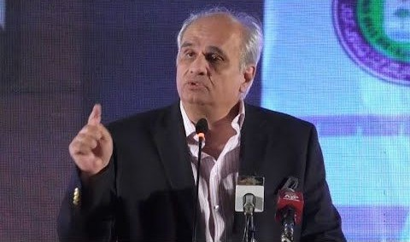





“TypeScript is a valuable tool for creating reliable and maintainable software applications. Its static typing, code clarity, and tooling support make it an excellent choice for beginners and experienced programmers alike. By learning TypeScript, you'll open doors to exciting career opportunities and gain the power to create your own digital solutions.”
—Sir Zia Khan

Slide 44
02
Setting Up Your Environment
To develop TypeScript applications, you will need to install the following tools

Slide 45
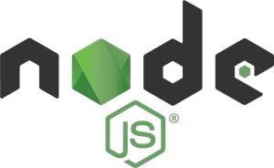



Setting Up Your Environment
Node.js is a runtime environment for JavaScript. It is used to run TypeScript code after it has been compiled to JavaScript.
Distributed version control system designed to handle everything from small to very large projects with speed and efficiency.
TypeScript is the compiler that converts TypeScript code to JavaScript.
VS Code is a popular code editor that has excellent support for TypeScript.

Slide 46
Chapter #2 Your FirSt TypeScript
Application

Slide 47
NodeJS InStallation

Slide 48
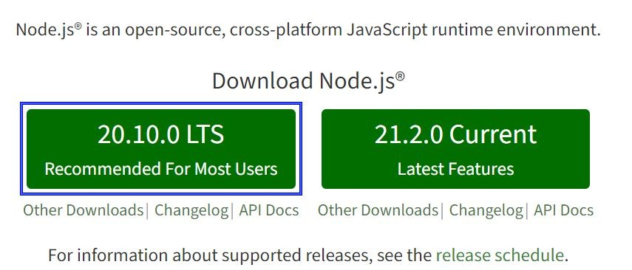
InStall Node.jS
Download the Node.js installer from the official website (https://nodejs.org/en) and run the installer.

Slide 49
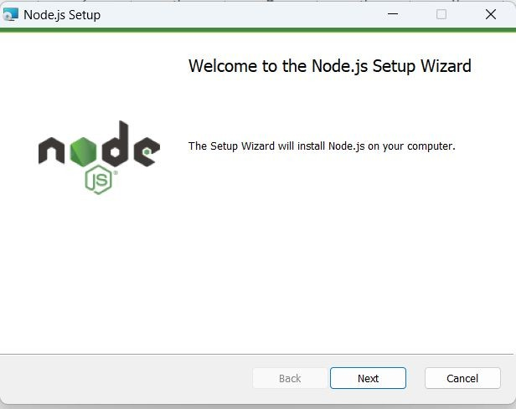

Slide 50
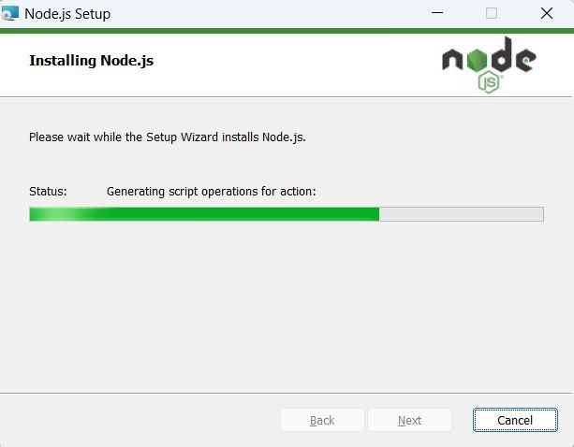

Slide 51
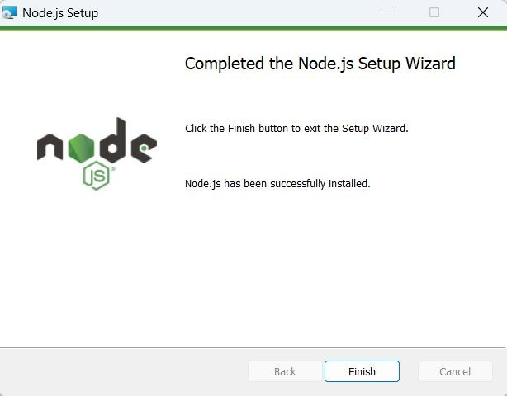

Slide 52
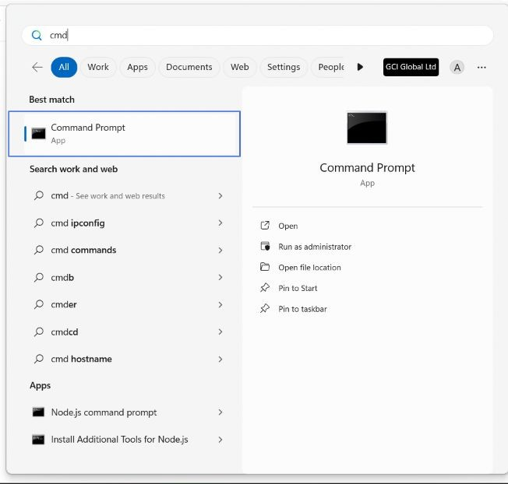

Slide 53
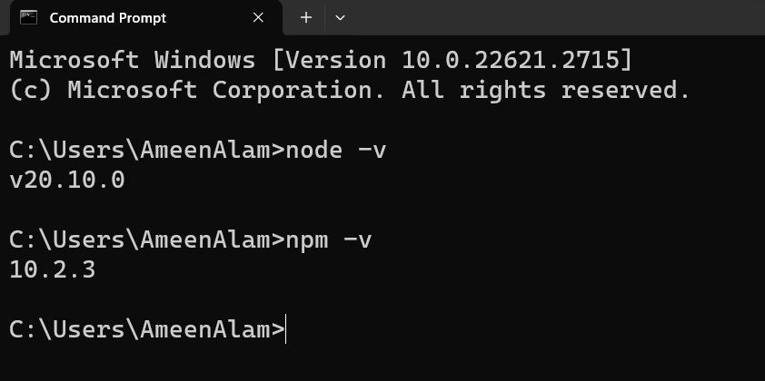

Slide 54
Git InStallation

Slide 55
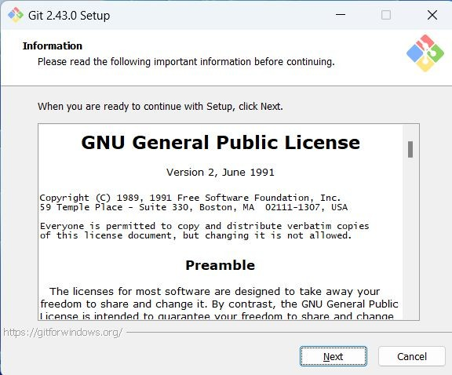

Slide 56
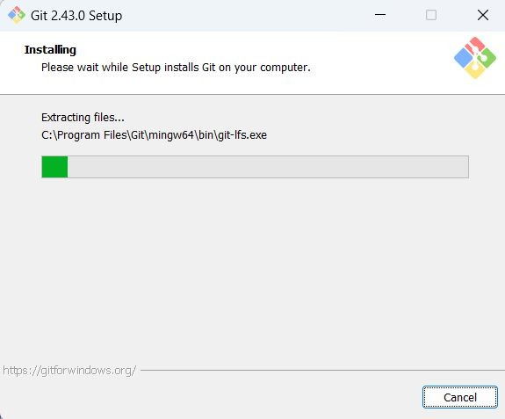

Slide 57
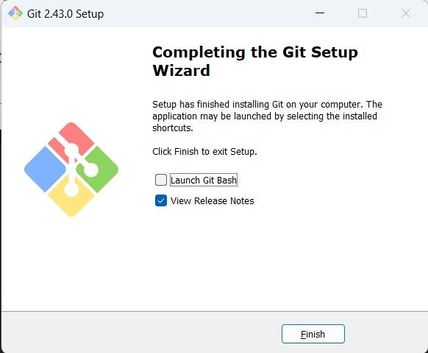

Slide 58
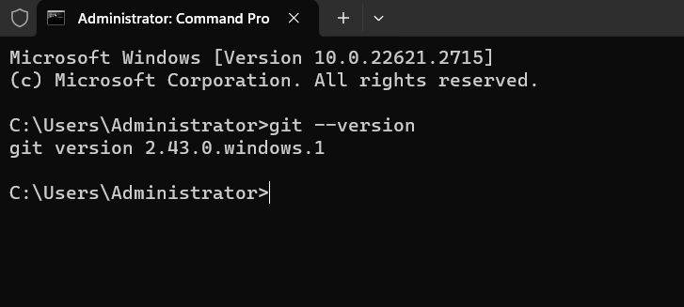

Slide 59
TypeScript InStallation

Slide 60
InStall TypeScript
Open a command prompt or terminal and run the following command:
npm install --global typescript@5.0.2 tsc --version

Slide 61
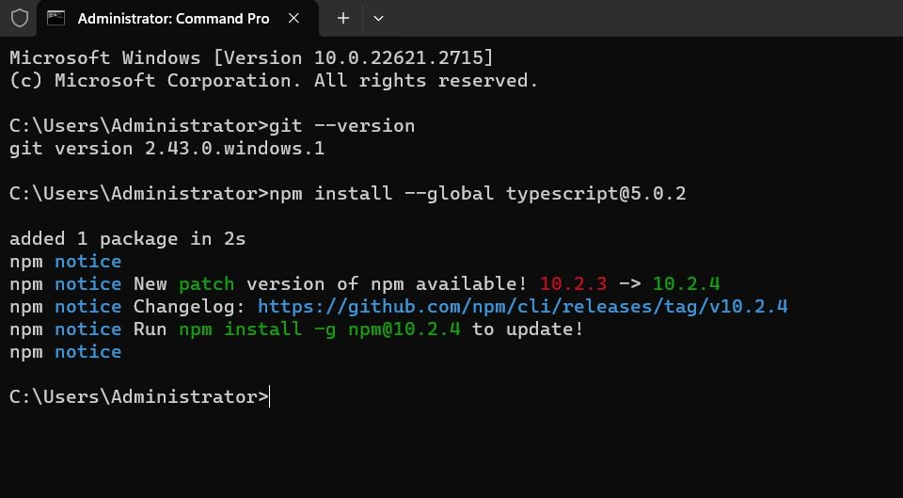

Slide 62
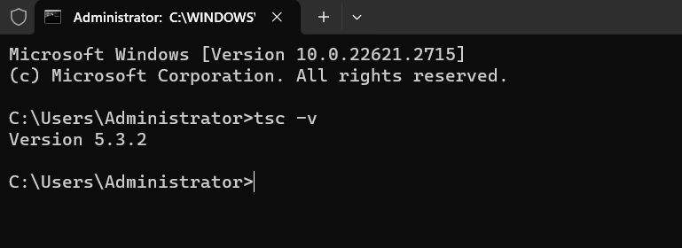

Slide 63
VS Code InStallation

Slide 64
InStall VS Code
Download VS Code from the official website (https://code.visualstudio.com/download) and install it.

Slide 65
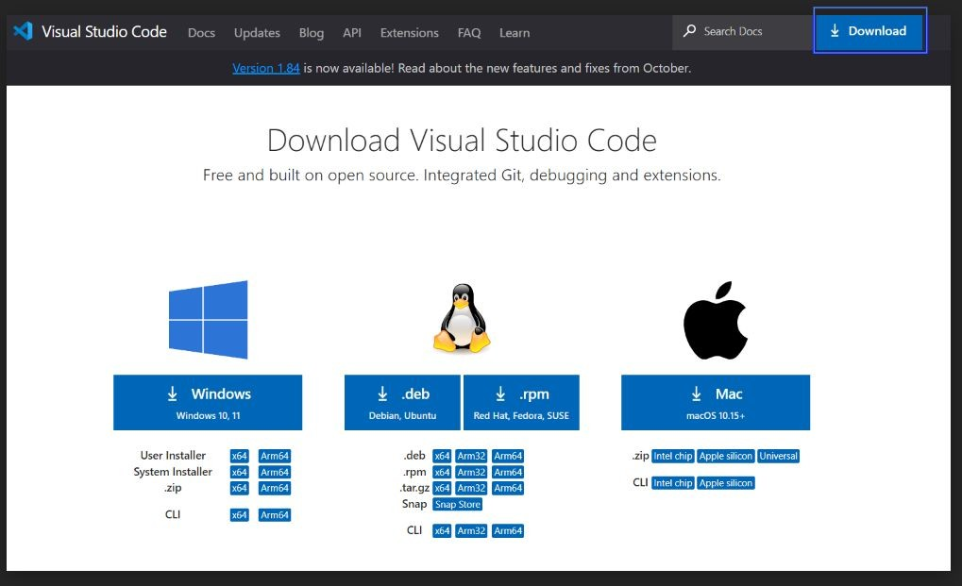

Slide 66
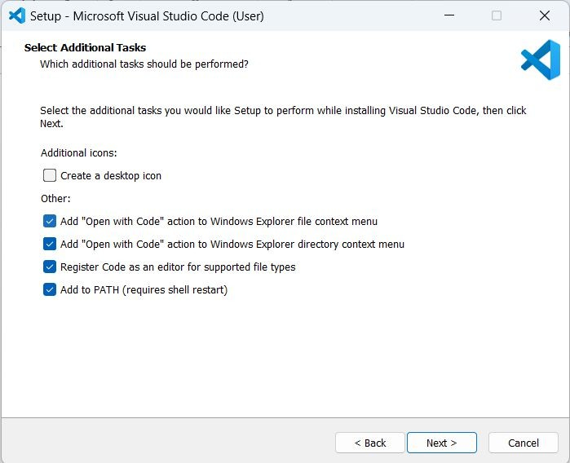

Slide 67
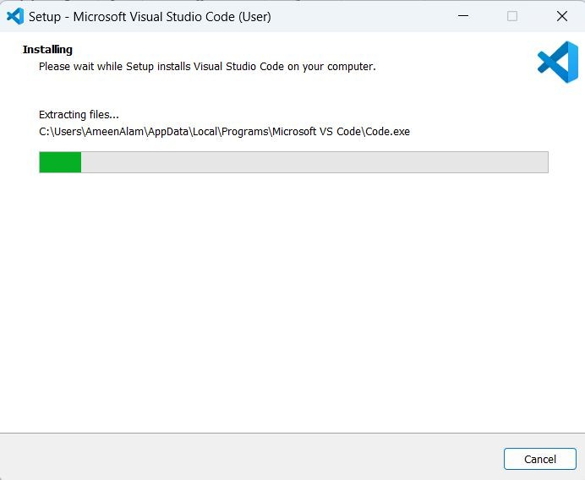

Slide 68
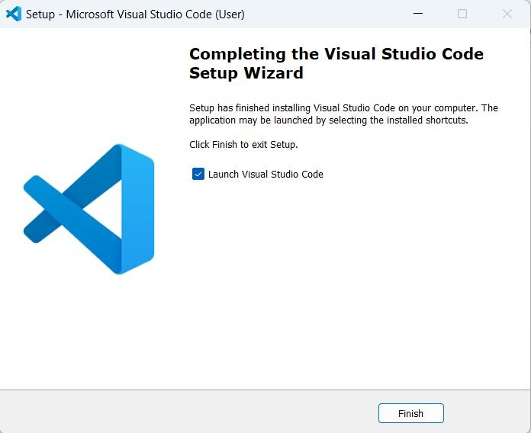

Slide 69
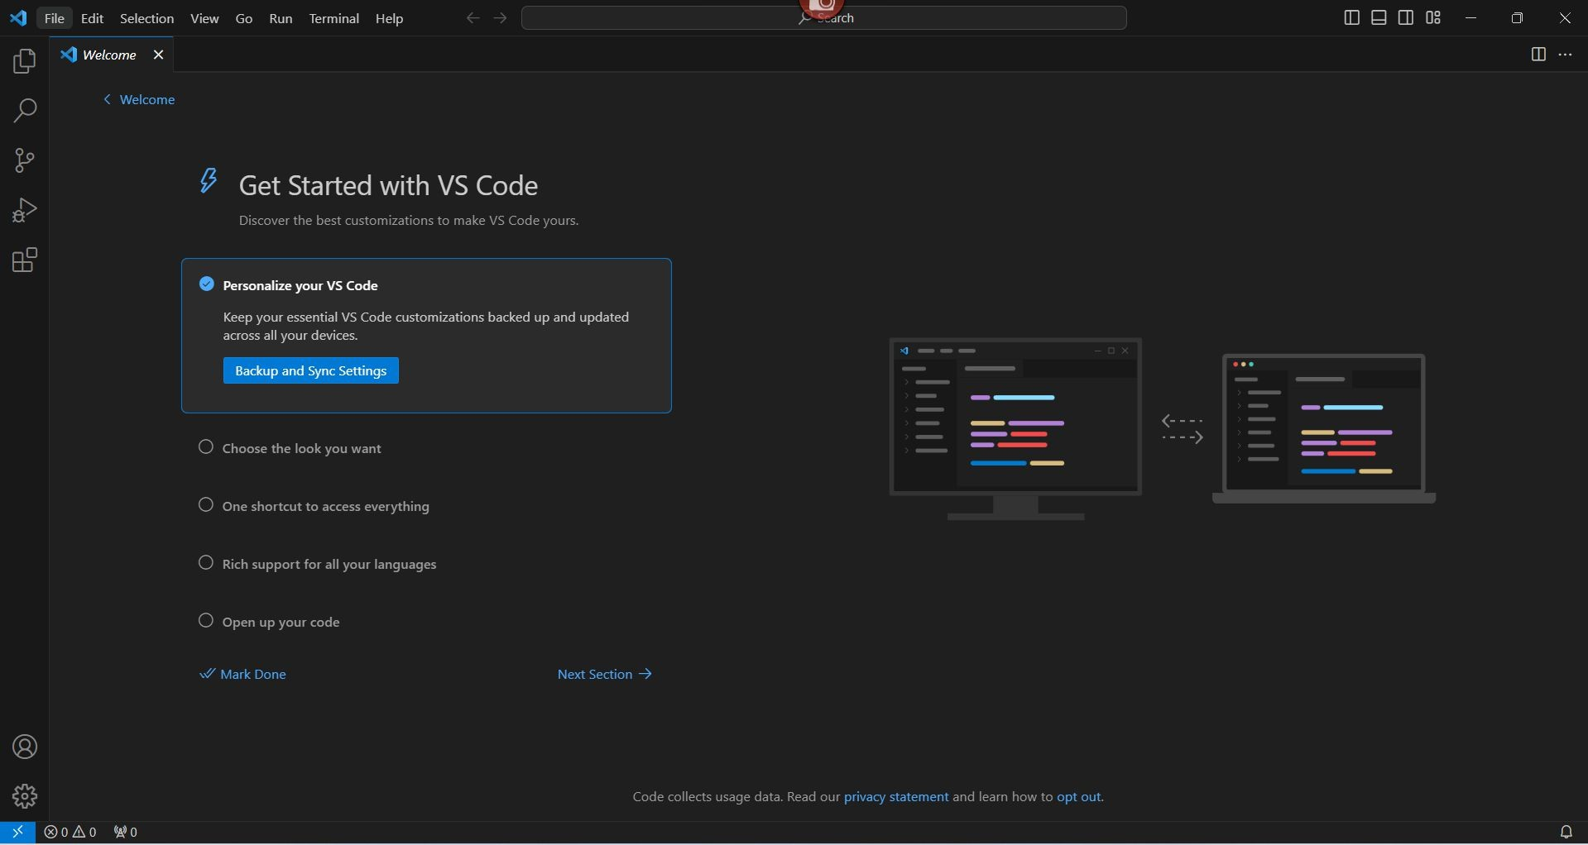

Slide 70
TypeScript ExtenSion

Slide 71
InStall the TypeScript extenSion
Open VS Code and go to Extensions > Search Extensions. Search for TypeScript and install the TypeScript: JavaScript with Language Features extension.

Slide 72
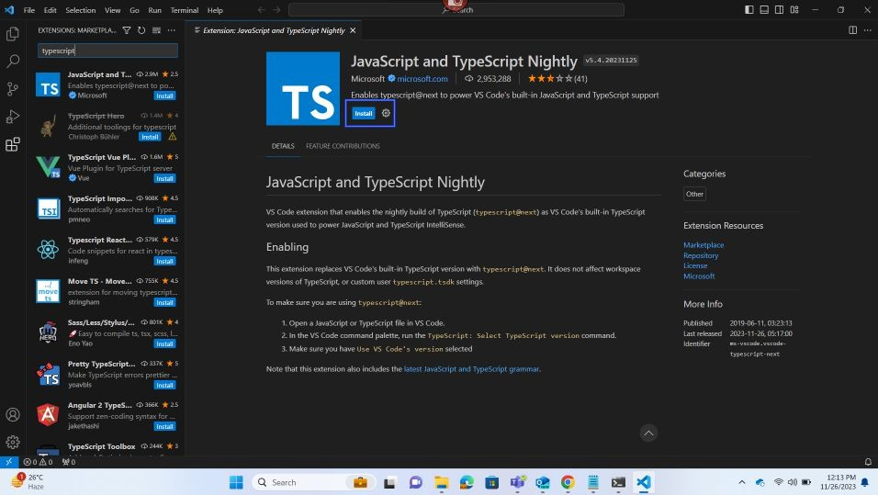

Slide 73
03
Your FirSt TypeScript Program
Let's write a simple "Hello, World!" program in TypeScript.

Slide 74
Hello World

Slide 75
Your FirSt TypeScript Program
Let's write a simple "Hello, World!" program in TypeScript.
console.log("Hello, World!");
This code will print the text "Hello, World!" to the console.

Slide 76
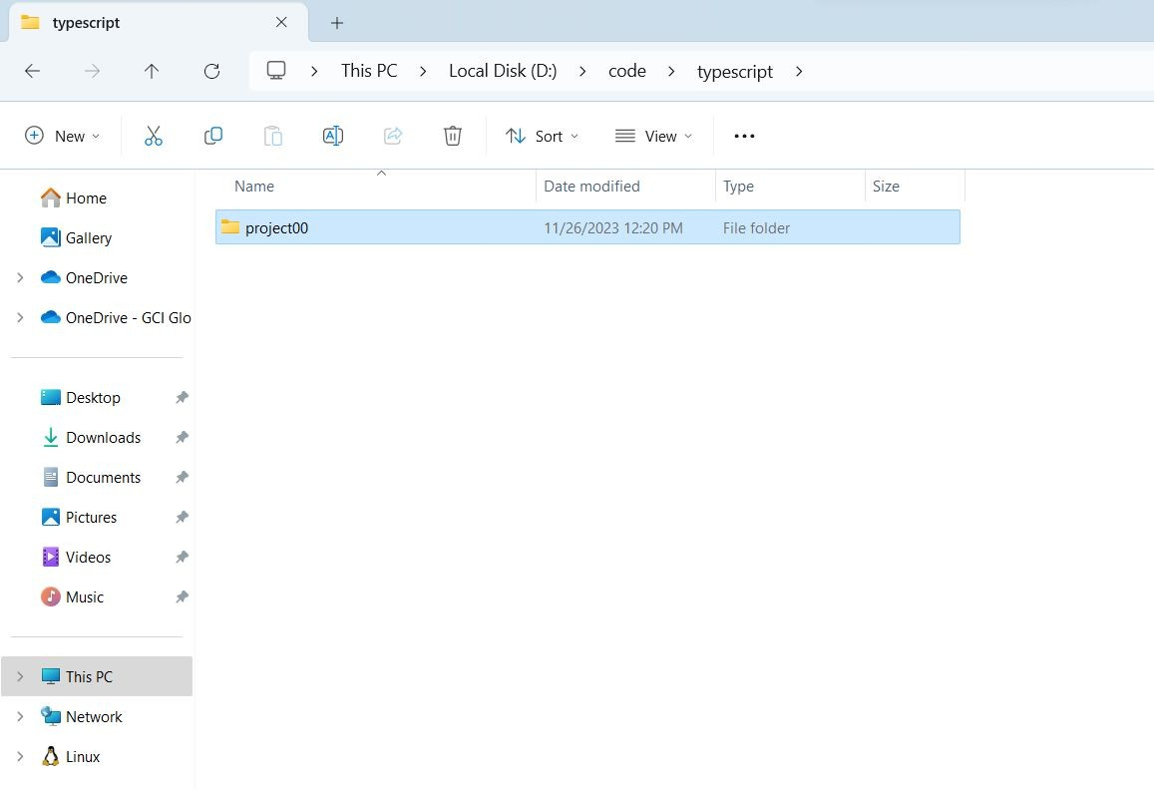

Slide 77
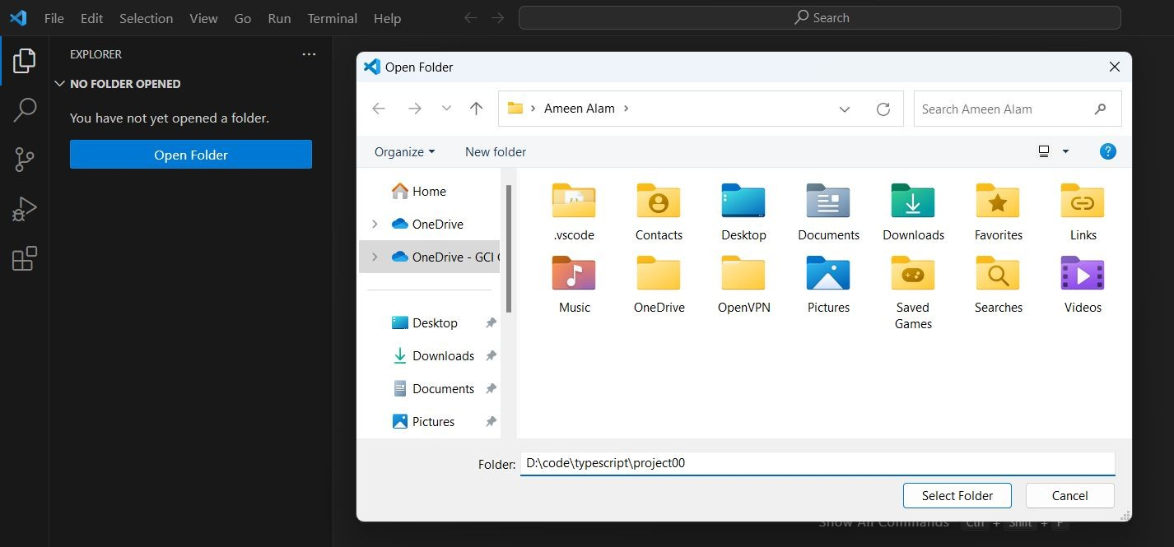
To Open Folder
CTRL + K CTRL + O

Slide 78
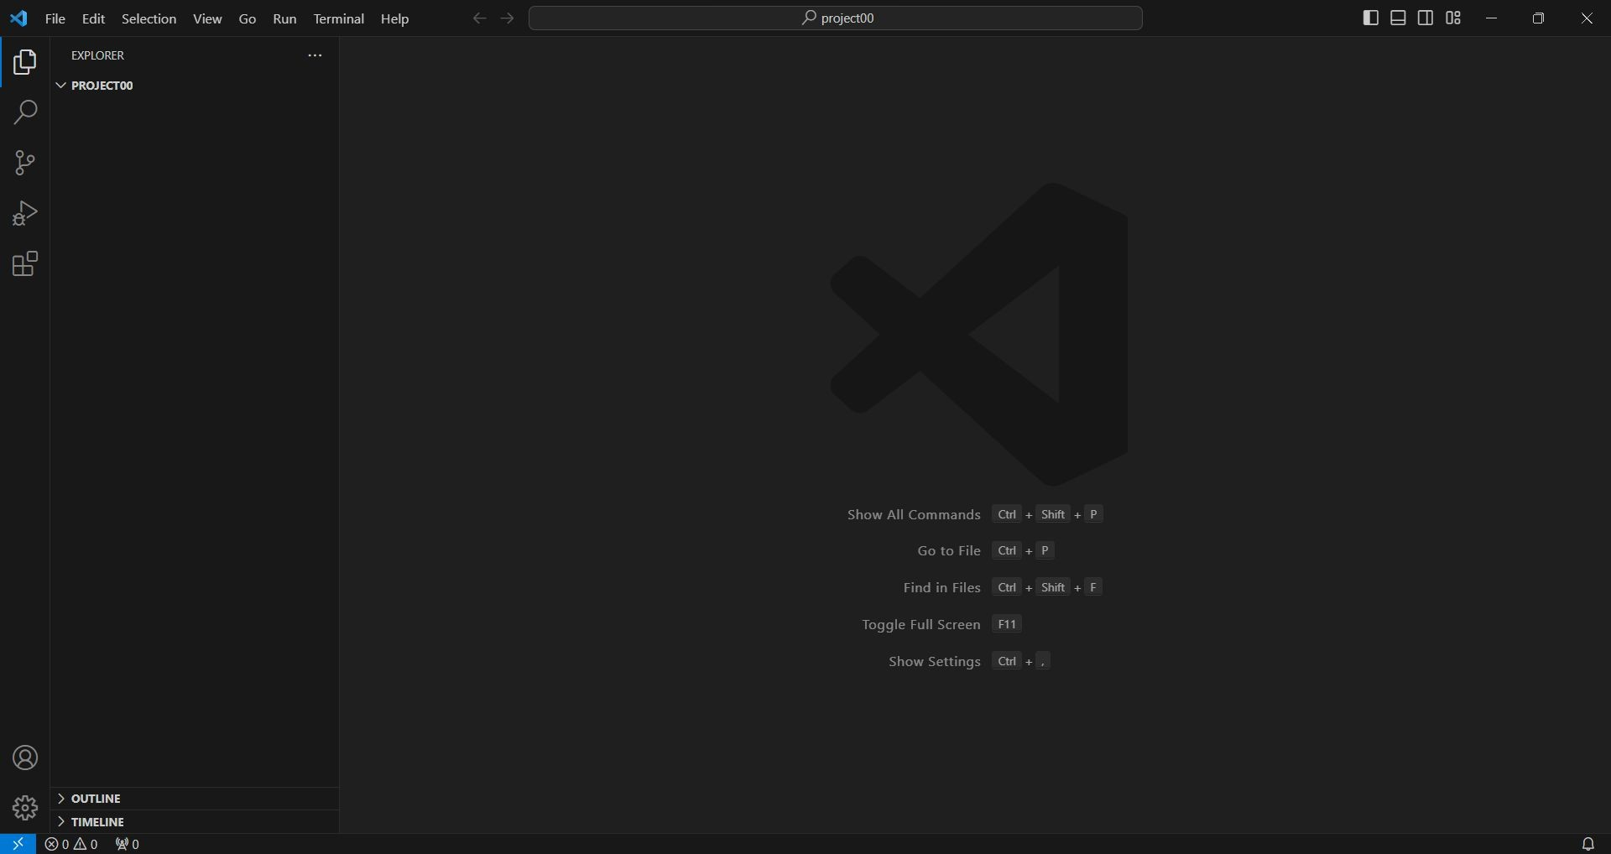

Slide 79
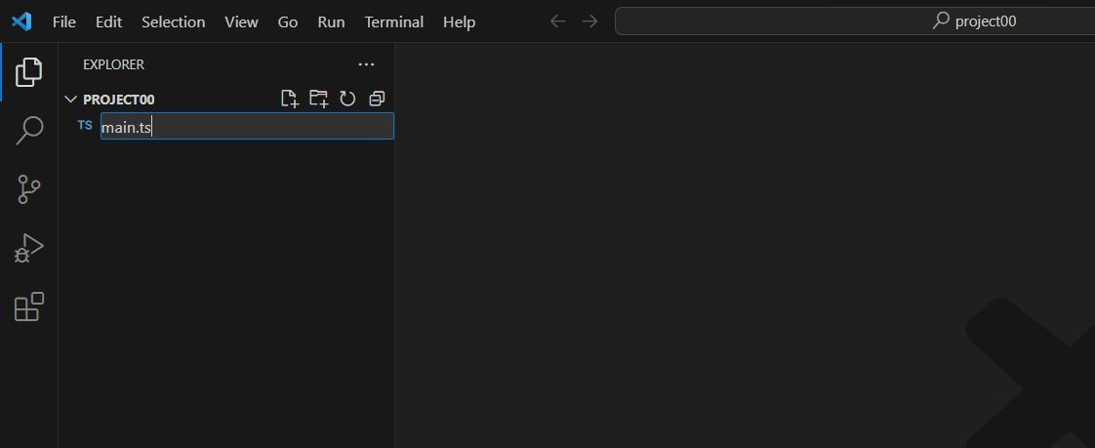

Slide 80
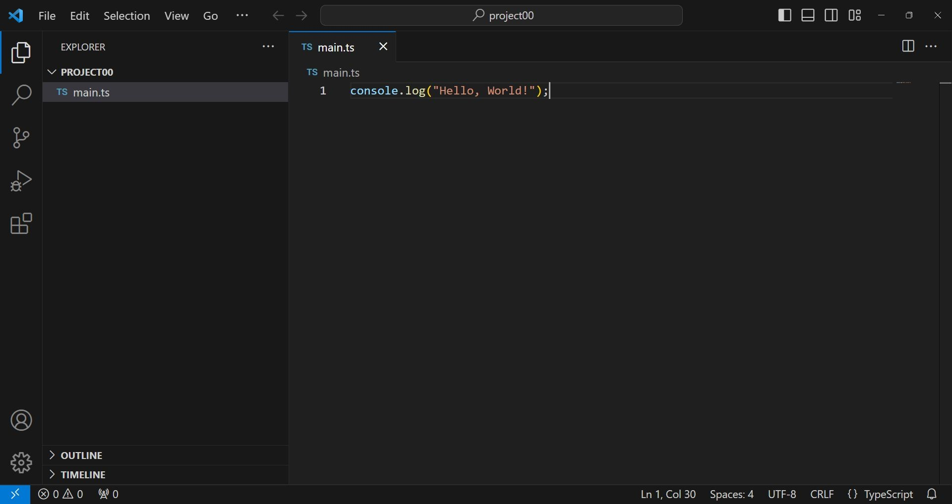

Slide 81
Compile thiS code to JavaScript
To compile this code to JavaScript, open a command prompt or terminal and navigate to the directory where you saved the TypeScript file. Then, run the following command:
tsc main.ts

Slide 82
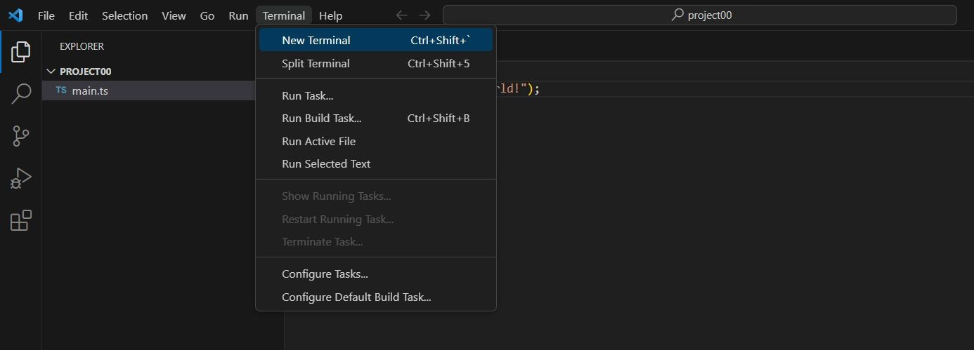

Slide 83
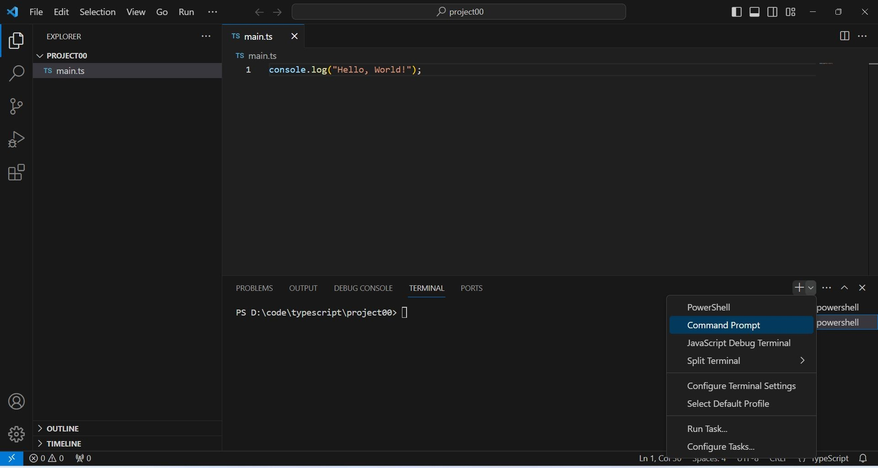

Slide 84
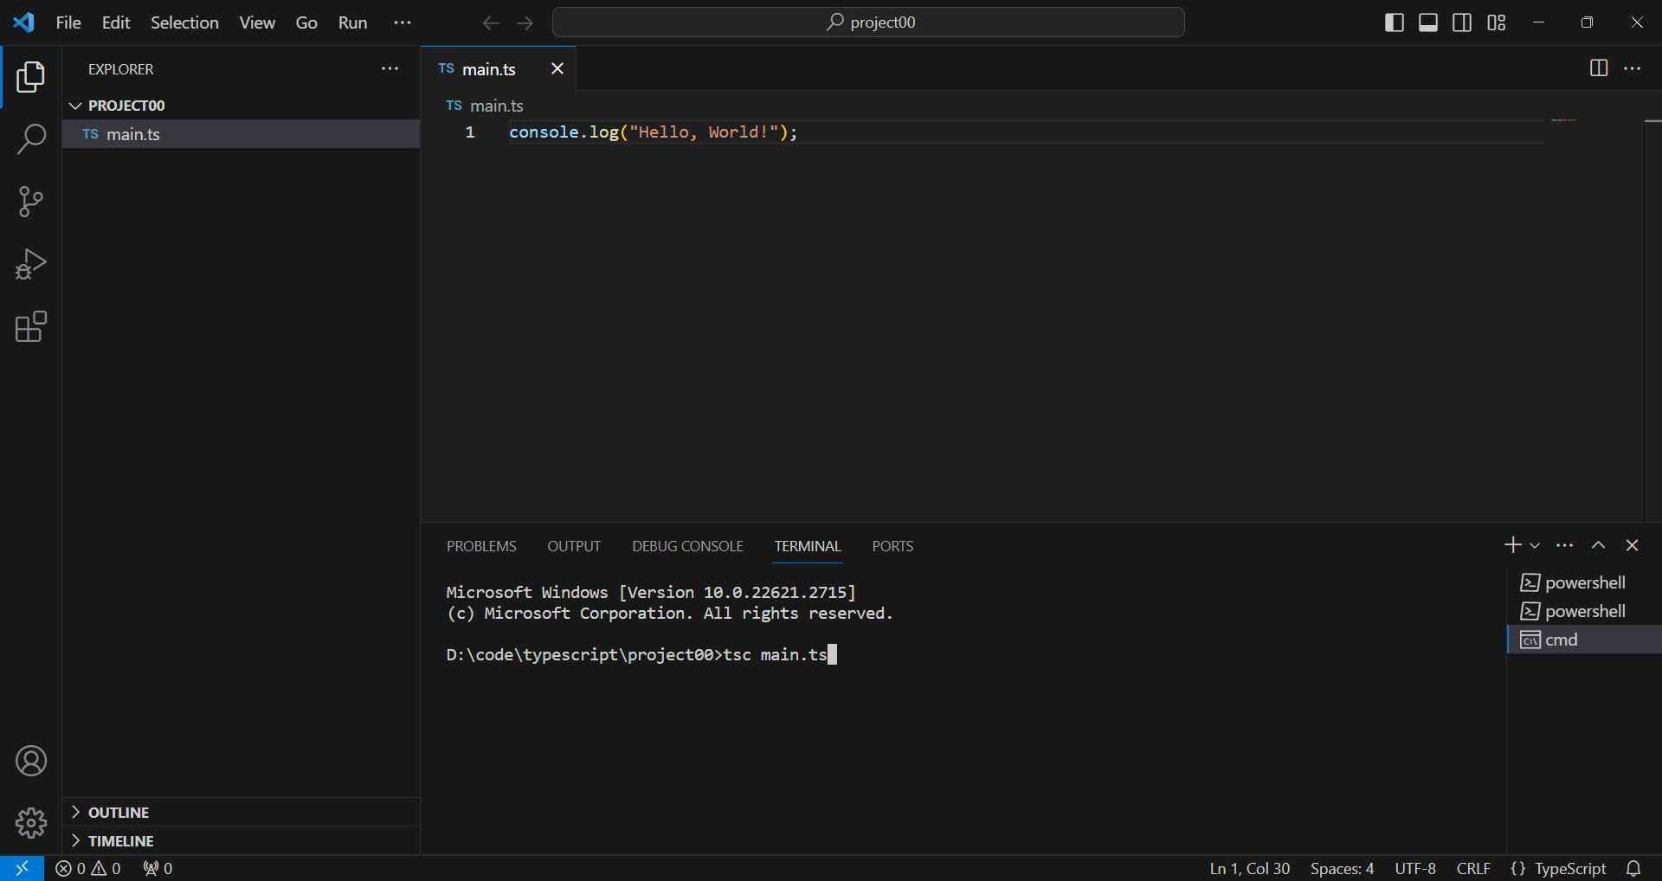

Slide 85
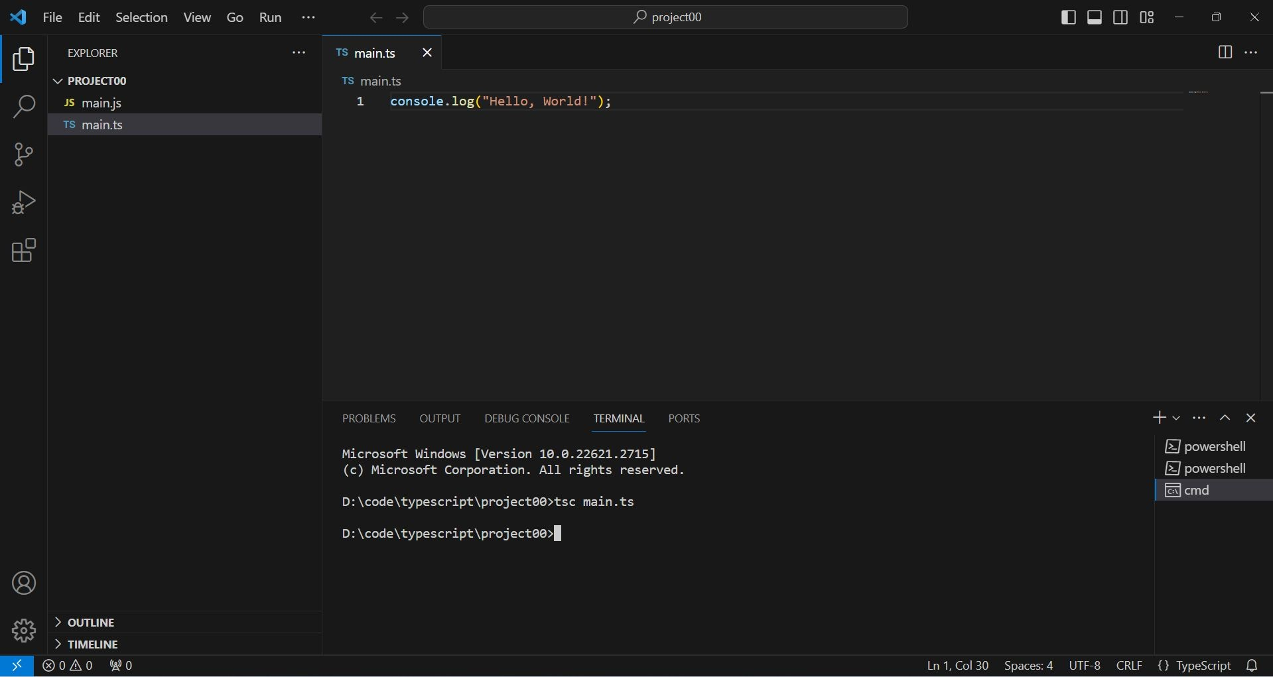

Slide 86
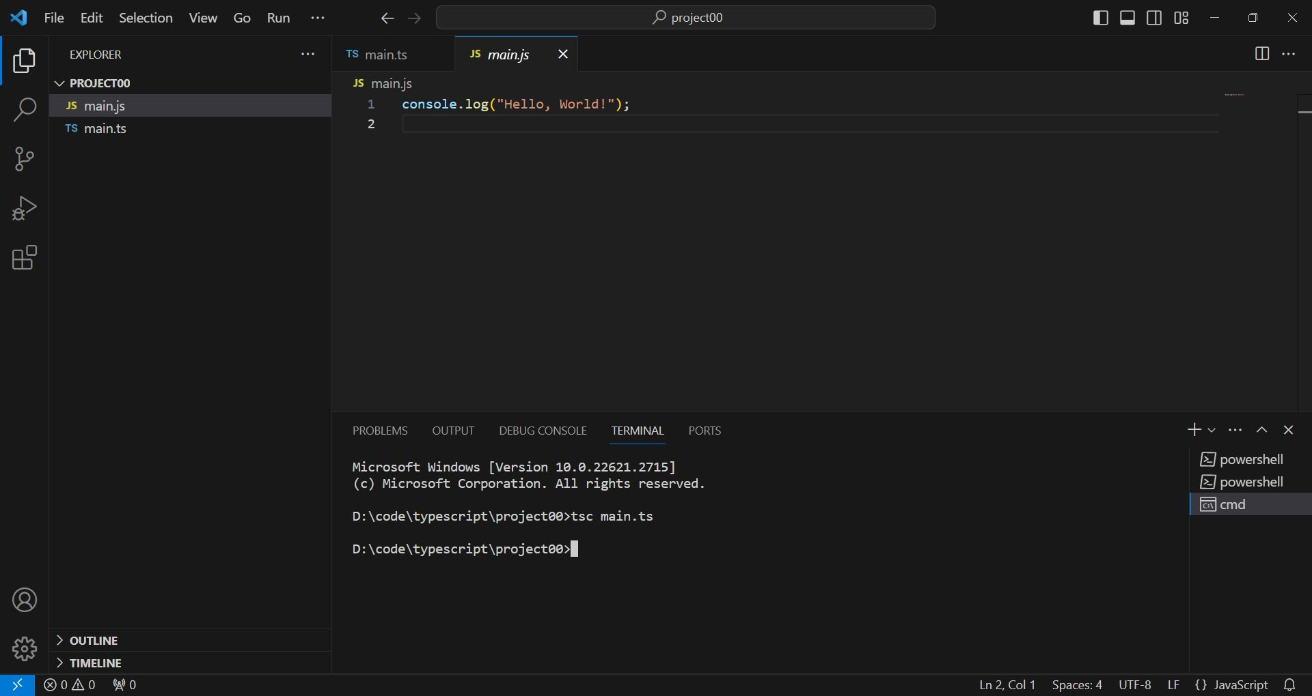

Slide 87
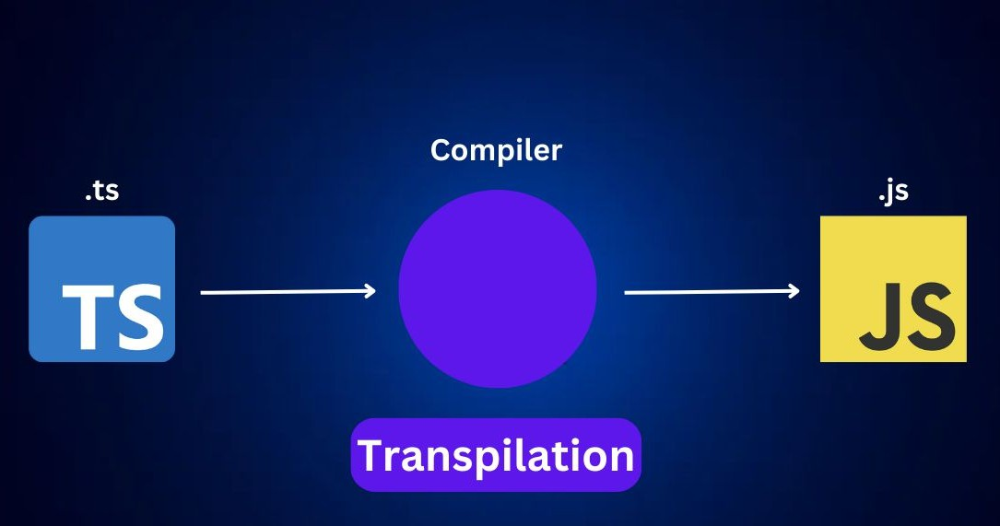

Slide 88
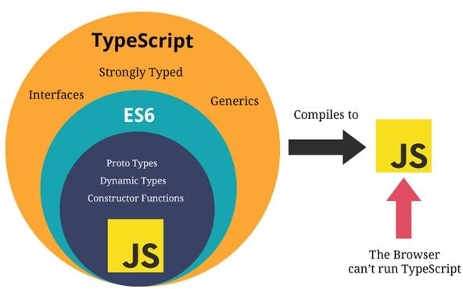

Slide 89
Compile thiS code to JavaScript
This will create a JavaScript file named main.js in the same directory. You can then run this JavaScript file using Node.js:
node main.js
This will print the text "Hello, World!" to the console.

Slide 90
CongratulationS

Slide 91
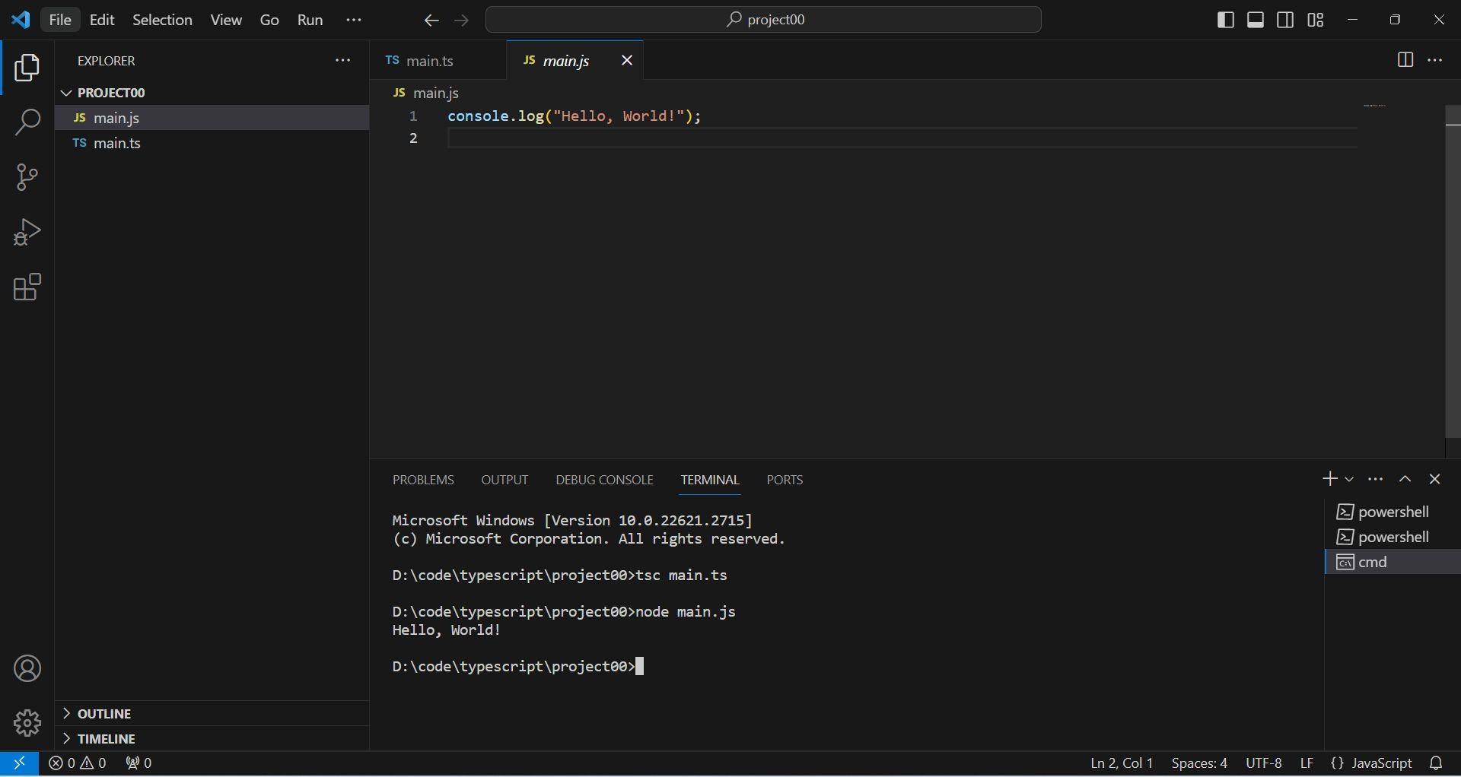
Congratulations

Slide 92

I’M A Programmer

Slide 93
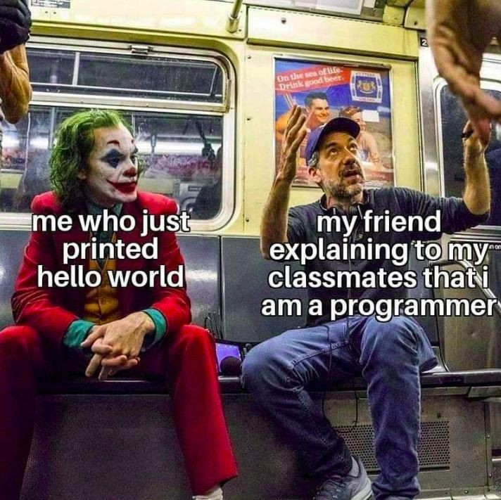
I’M A
Programmer

Slide 94
Problem-Solving PoWer15
We'll dedicate 15 minutes to a focused question-and-answer session.

Slide 95
Problem-Solving PoWer15
Bring your specific problems and questions to the table.
Collaborate with fellow students and learn from their inquiries.
Receive personalized guidance and feedback from experienced faculty.
Gain valuable insights and sharpen your troubleshooting skills.

Slide 96
BenefitS Of dttending
Boost your problem-solving expertise: Develop a structured approach to analyzing and solving programming challenges.
Sharpen your coding skills: Practice writing efficient and effective code through engaging exercises.
Enhance your understanding: Gain deeper insights into key programming concepts and applications.
Build your confidence: Feel empowered to tackle complex tasks and independent learning.

Slide 97






Slide 98
PdndVerSe Ledrn TypeScript

Slide 99
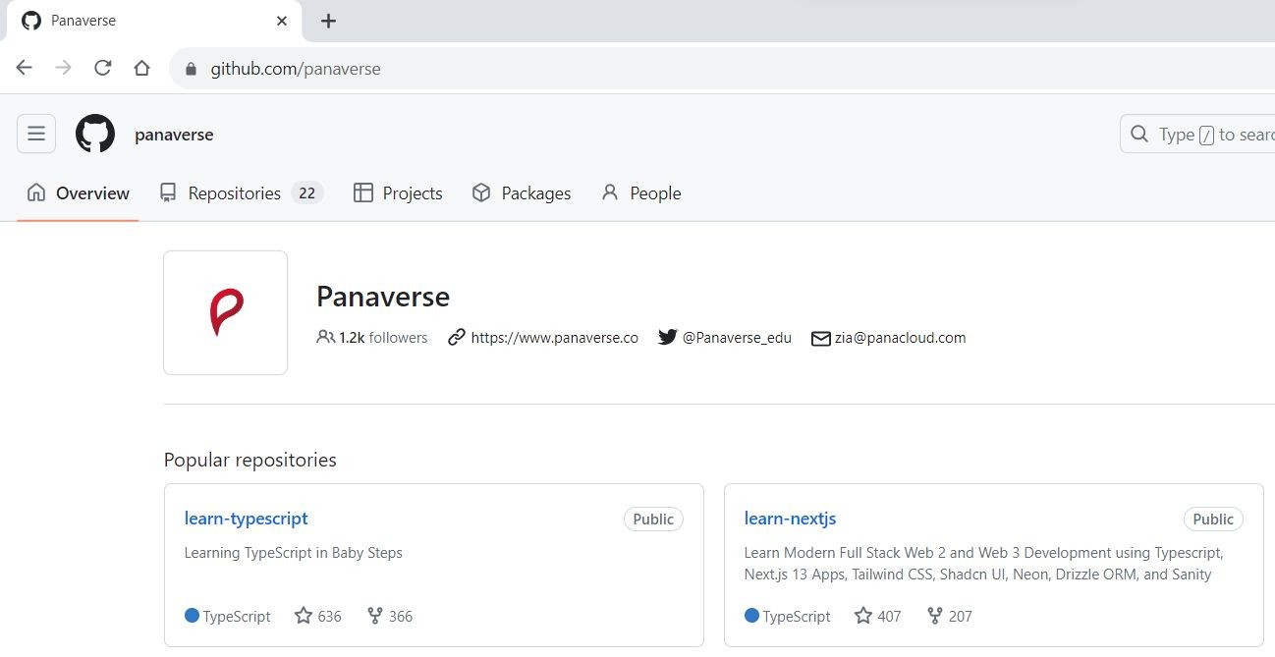
Ledrn TypeScript 5.0+ in Bdby StepS
https://github.com/panaverse/learn-typescript

Slide 100
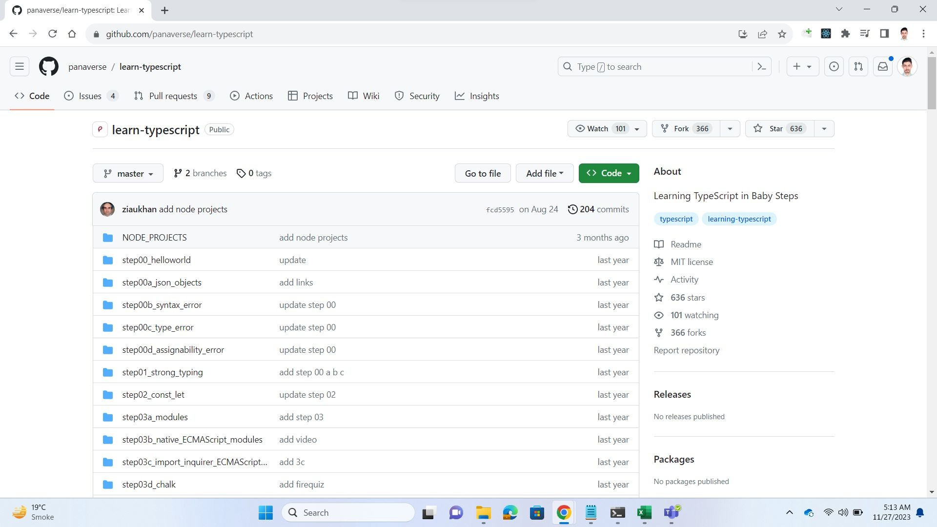

Slide 101
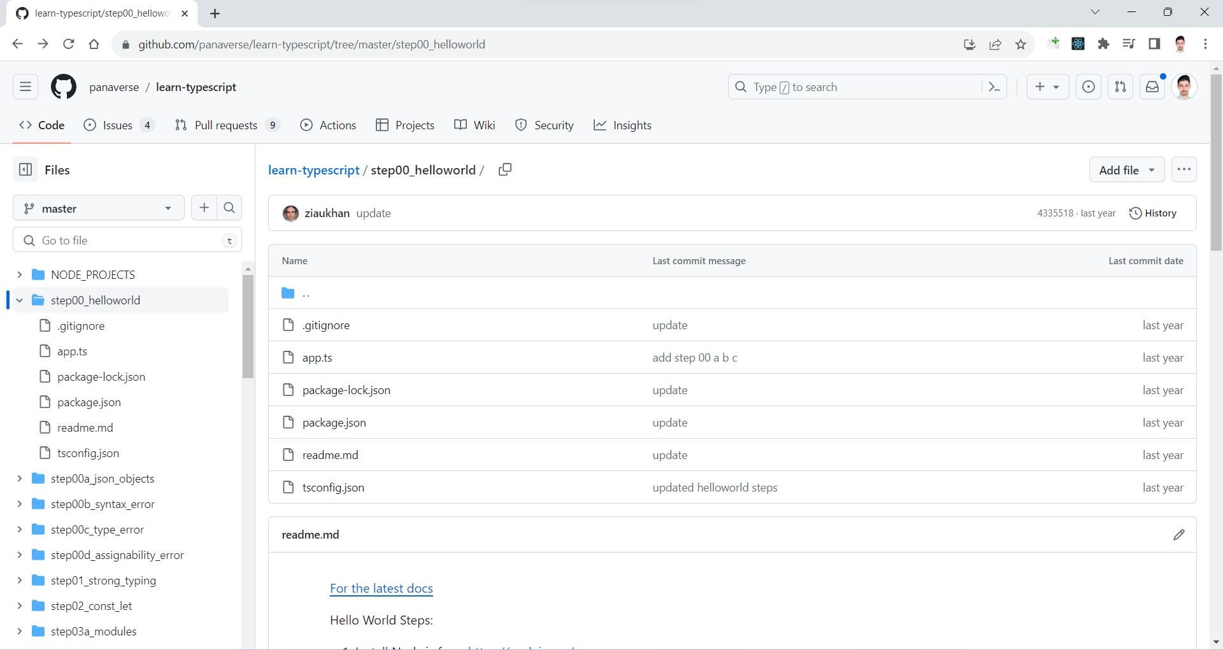

Slide 102
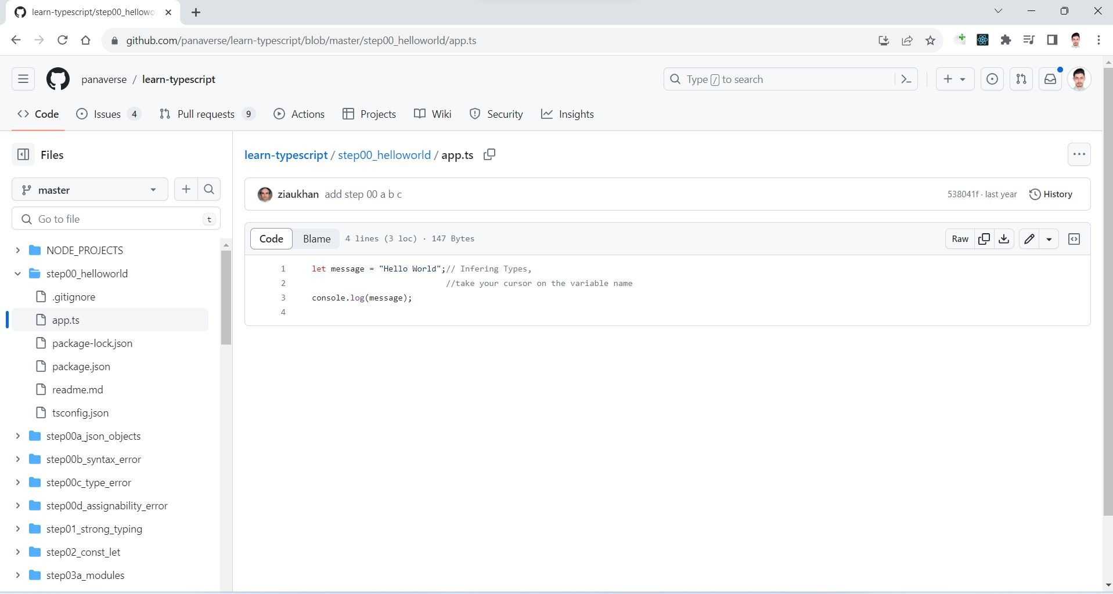

Slide 103
Step00_hellOWOrld

Slide 104
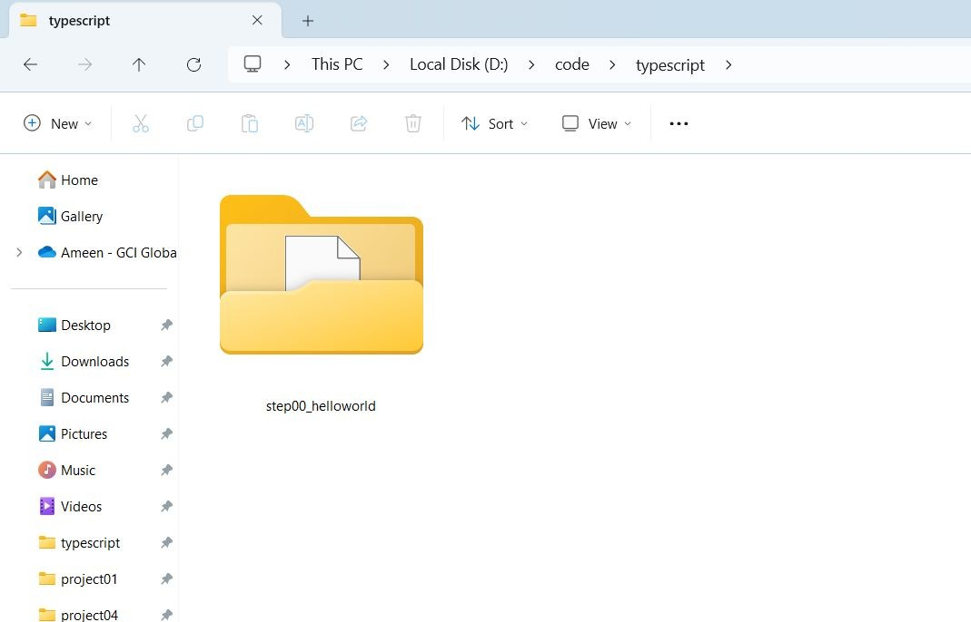
Create a new directory - step00_helloworld

Slide 105
Generdte tScOnfig.jSOn by giving thiS cOmmdnd:
Press Shift+ right-click in the folder you want to open Command Prompt. Now from the context menu, select the “Open command window here” option.
tsc --init

Slide 106
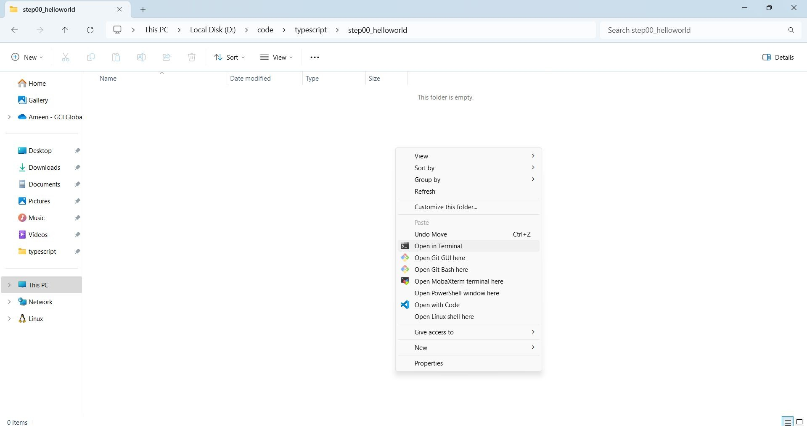
Press Shift+ right-click in the folder you want to open Command Prompt. Now from the context menu, select the “Open command window here” option

Slide 107
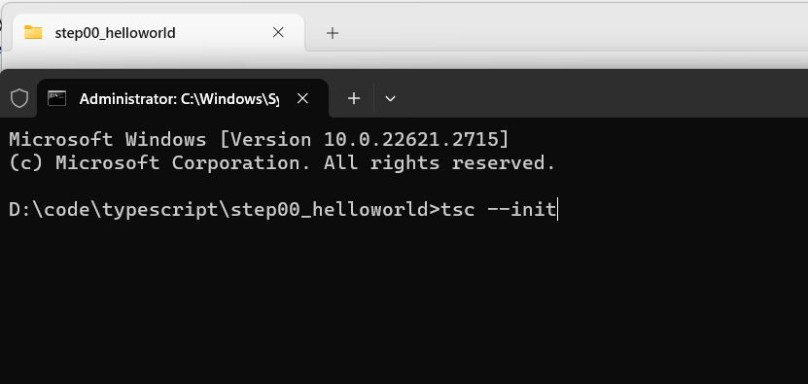

Slide 108
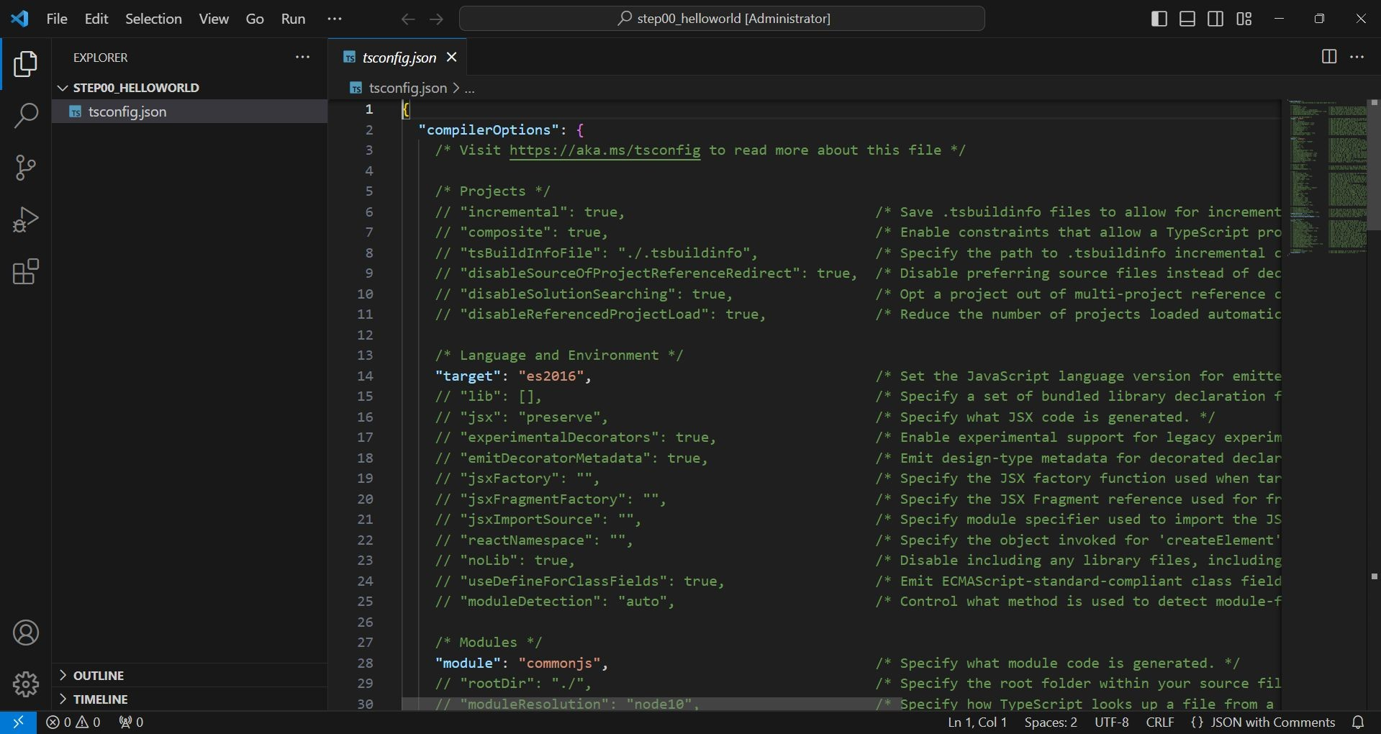

Slide 109
Credting the cOmpiler cOnfigurdtiOn file - TypeScript
To define the configuration for
the TypeScript compiler, create a file called tsconfig.json

Slide 110
I describe the TypeScript compiler in chapter 5

Slide 111

Make it a Node.js project by giving the following command:
npm init -y

Slide 112


Slide 113
Initidlizing The PrOject FOlder - NOdeJS
The npm init command creates a package.json file, which is used to keep track of
the packages required by the project and also to configure the development tools.

Slide 114

Install types for Node.js
npm i @types/node -D

Slide 115


Slide 116

Create .gitignore file

Slide 117

Create file app.ts
Write message variable Print message in console

Slide 118

Running the compiler Transpile typescript to javascript

Slide 119


Slide 120

COmpiling dnd Executing
Congratulations

Slide 121
04
HdndS-On ExerciSeS
Getting Started Exercises with TypeScript and Node.js

Slide 122
Getting Stdrted ExerciSeS With TypeScript dnd NOde.jS
Note: Try these short programs to get some firsthand experience with TypeScript and Node.js. You might want to create a new folder for each exercise to keep them organized. Create a single Github repository to commit the code for these exercises and once finished submit the URL of the repo.

Slide 123
Assignment Competition

Slide 124
Getting Stdrted ExerciSeS With TypeScript dnd NOde.jS
Who will be the first to complete TypeScript and Node.js exercises ?
https://github.com/panaverse/learn-typescript/blob/ master/NODE_PROJECTS/getting-started-exercises. md

Slide 125


Slide 126
PrOject COmpetitiOn

Slide 127
TypeScript NOde PrOjectS
Who will be the first to complete TypeScript Node Projects ?
https://github.com/panaverse/learn-typescript/tree/ master/NODE_PROJECTS

Slide 128


Slide 129
Submit yOur prOjectS here
TypeScript Project Submission Form
We'll share the link with you later.

Slide 130
Documentdtion

Slide 131


Slide 132

https://github.com
Stdrt YOur JOurney NOW: Sign Up fOr Github
Version Control using Git and GitHub By Sir Zeeshan Hanif (Watch Recorded Videos):
https://bit.ly/4bqeUZm

Slide 133


















Thanks!
https://linktr.ee/ameenalam
fb.com/SheikhAmeenAlam
linkedin.com/in/ameen-alam
instagram.com/sheikhameenalam
yt.com/ameenalamofficial
Presented by Sir Ameen Alam

